Slide 1

Design Credit
Prediction of Mechanical properties using Machine Learning

Slide 2

Deliverables:
To implement machine learning model on different alloy compositions to predict mechanical properties of that alloy system.
Tuning hyper-parameters to obtain best model for the prediction.

Slide 3
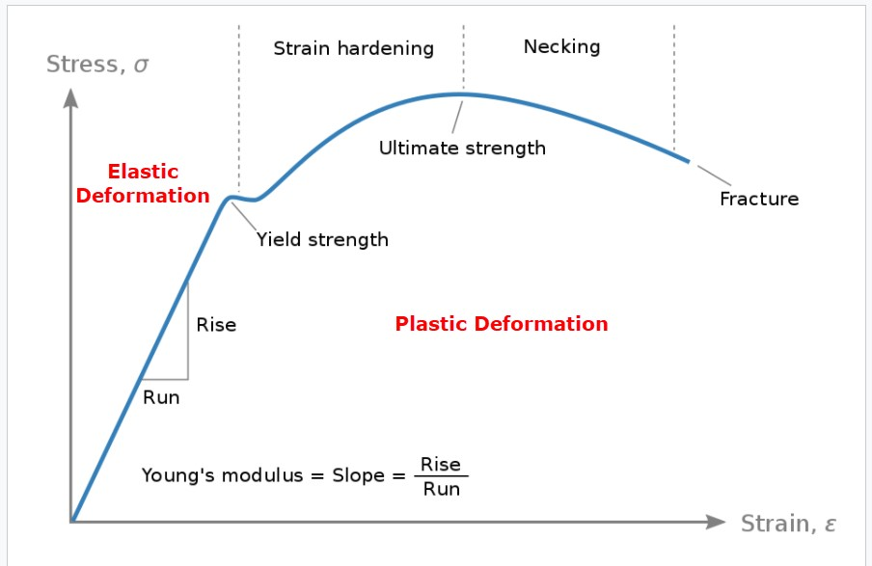
Introduction
The mechanical properties of a material affect how it behaves as it is loaded.
The elastic modulus of the material affects how much it deflects under a load
The strength of the material determines the stresses that it can withstand before it fails.
The ductility of a material also plays a significant role in determining when a material will break as it is loaded beyond its elastic limit.
There are a lot of parameters to affect mechanical properties such as microstructure, heat treatment, process method, composition etc.

Slide 4
Dataset
Mechanical properties of low-alloy steels Dataset from National Institute of Material Science (NIMS) MatNavi was used in this work, which is one of the largest databases in the world with details on composition and subsequent processing (heat treatment) parameters.
Feature Description:
Materials: C (Carbon), Si (Silicon), Mn (Manganese), P (Phosphorus), S (Sulfur), Ni (nickel),Cr (Chromium), Mo (Molybdenum), Cu (Copper), V (Vanadium), Al (Aluminum), N (Nitrogen), Ceq (Carbon Equivalent), Nb + Ta (Niobium + Tantalum)
Temperature (°C)
Mechanical Properties: 0.2% Proof Stress (MPa), Tensile Strength (MPa), Elongation (%), Reduction in Area (%)

Slide 5
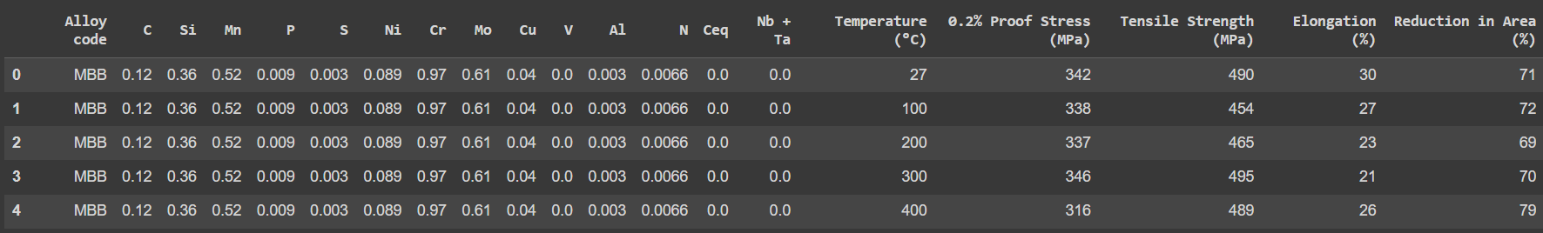

Slide 6

Google colab notebook : Design_Credit

Slide 7
Correlation of Features
Temperature has significant influence on % Elongation and % Reduction in area.
0.2% Proof Strength is highly influenced by presence of V, Ni, Mn, Mo, Ceq, Si, Al, Cr, C and Cu in decreasing order.
Tensile Strength is highly influenced by presence of V and moderately influenced by presence of Mo, Ni, Cr, C and Mn in decreasing order.
Tensile Strength is also highly related to 0.2% Proof Strength.

Slide 8
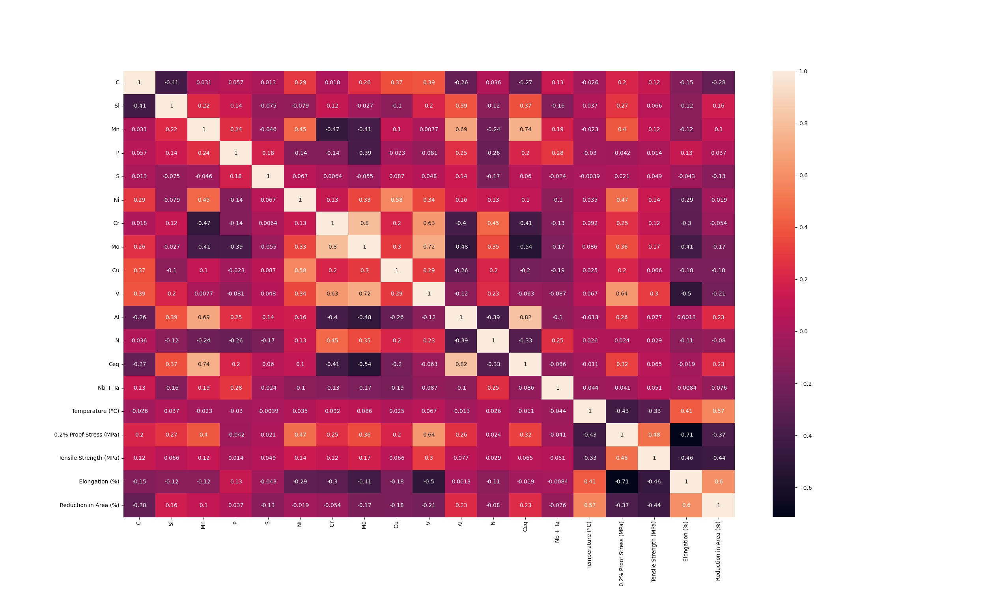
Correlation image

Slide 9
Correlation of Features
% Elongation and % Reduction in Area show maximum correlation with each other followed by temperature.
% Elongation is moderately influenced by presence of P and slightly influenced by presence of Al
% Reduction in Area is moderately influenced by presence of Al, Ceq, Si and Mn.

Slide 10
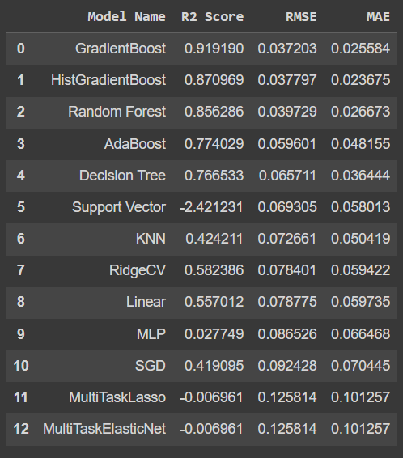
Modelling
The dataset is first scaled down, and then splitted into training ,testing and validation data. Different models are trained on the training data and evaluation result on validation data is obtained.

Slide 11
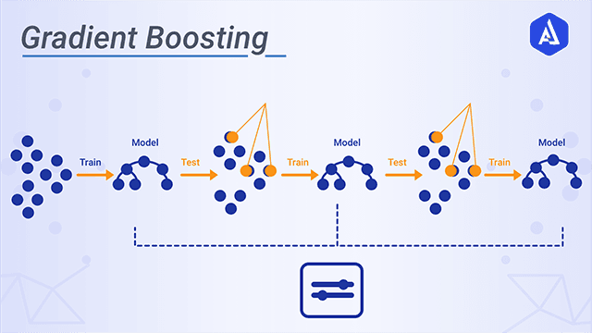
Gradient Boosting Regressor
The best model obtained from the results is Gradient Boosting Regressor.
Why this model giving better results than the others?

Slide 12
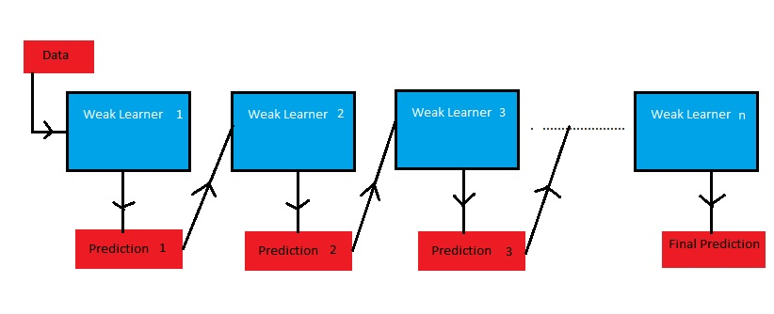
Gradient boost is a machine learning algorithm which works on the technique called 'Boosting'.
Gradient boost sequentially combines many weak learners to form a strong learner.
Typically Gradient boost uses decision trees as weak learners.
Gradient boost is one of the most powerful techniques for building predictive models for both classification and Regression problems.

Slide 13
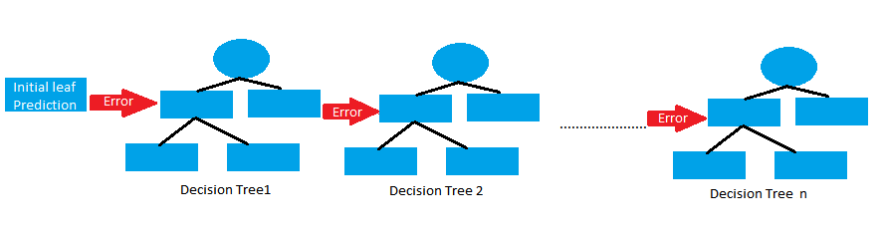
To understand the Gradient boost below are the steps involved. In Gradient boosting weak learners are decision trees.
Step1: Construct a base tree with single root node. It is the initial guess for all the samples.
Step2: Build a tree from errors of the previous tree.
Step3: Scale the tree by learning rate (value between 0 and 1). This learning rate determines the contribution of the tree in the prediction
Step4: Combine the new tree with all the previous trees to predict the result and repeat step 2 until maximum number of trees is achieved or until the new trees don't improve the fit.
The final prediction model is the combination of all the trees.

Slide 14
Parameters
Tree-Specific Parameters : These affect each individual tree in the model.
Boosting Parameters : These affect the boosting operation in the model.
Miscellaneous Parameters : Other parameters for overall functioning.

Slide 15
1. Boosting Parameters
learning_rate :This determines the impact of each tree on the final outcome.
n_estimators The number of sequential trees to be modeled.
subsample The fraction of observations to be selected for each tree.
2. Tree-specific Parameters
min_samples_split : Defines the minimum number of samples (or observations) which are required in a node to be considered for splitting.
max_leaf_nodes : The maximum number of terminal nodes or leaves in a tree.
max_features : The number of features to consider while searching for a best split. These will be randomly selected.
3. Miscellaneous Parameters
loss : It refers to the loss function to be minimized in each split.
random_state :The random number seed so that same random numbers are generated every time. This is important for parameter tuning.
criterion : The function used to measure the quality of a split

Slide 16

Results
After tuning the hyper-parameters and implementing best values for the parameters in the final model the prediction is made on testing data which was neither used in training nor for evaluating , so this data is completely new for the model.
Final evaluations :
{'r2score': 0.9092742726190375,
'rmse': 0.04141613821415667,
'mae': 0.026643070220401882}

Slide 17
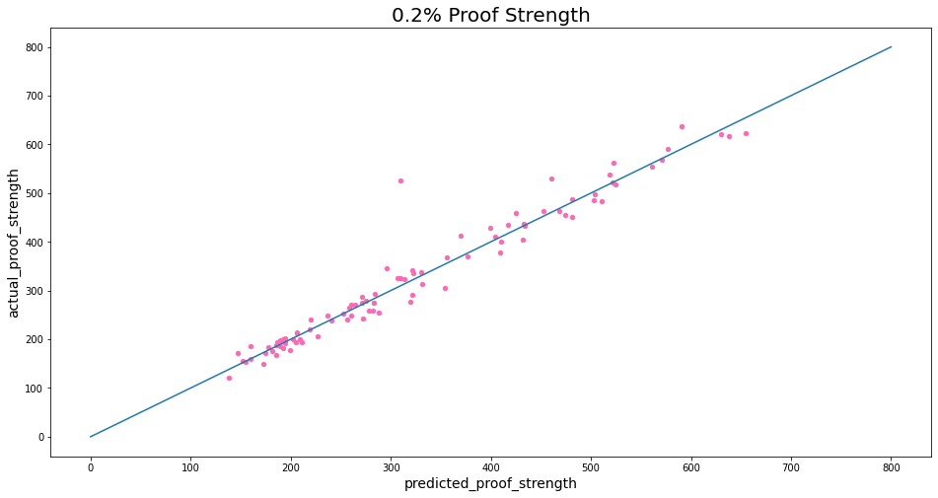

Slide 18
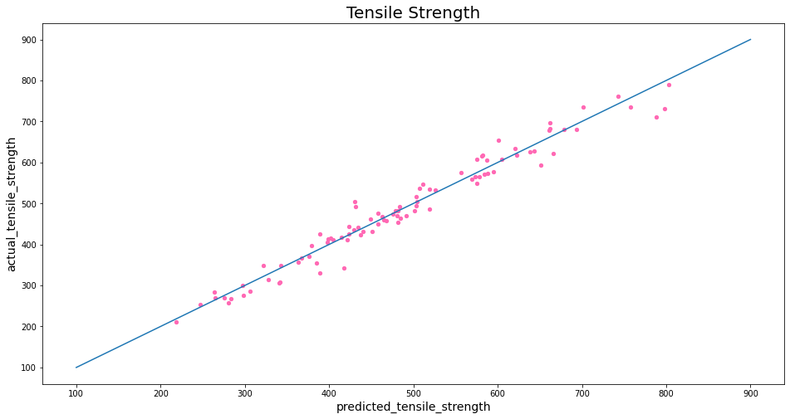

Slide 19
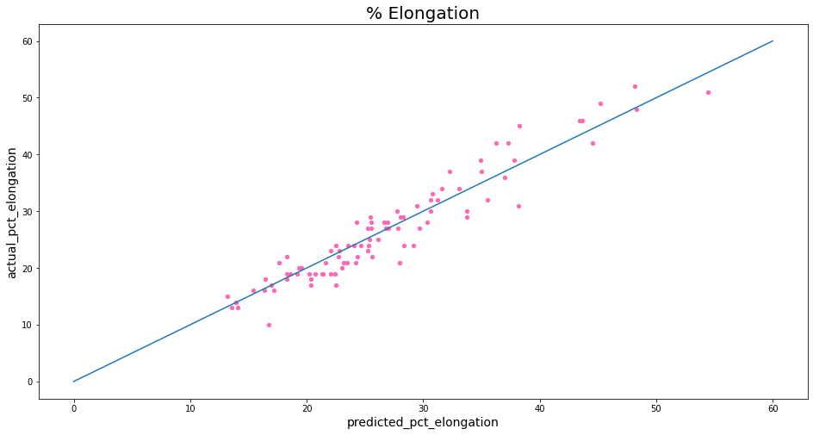

Slide 20
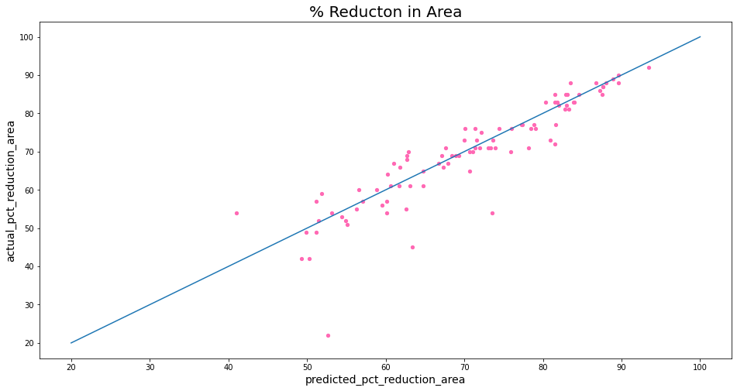

Slide 21
Thank You

